Slide 1
FACE RECOGNITION
BY:
TEAM 1
BILL BAKER
NADINE BROWN
RICK HENNINGS
SHOBHANA MISRA
SAURABH PETHE

Slide 2
FACE RECOGNITION
BIOMETRICS
EVOLVING APPROACHES TO RECOGNIZING FACES:
  EIGENFACE TECHNOLOGY
  LOCAL FEATURE ANALYSIS
  NEURAL NETWORK TECHNOLOGY
ADVANTAGES/DISADVANTAGES
FUTURE

Slide 3
FACE RECOGNITION:
What is it ?

Slide 4
BIOMETRICS
Biometrics - digital analysis using cameras or scanners of biological characteristics such as facial structure, fingerprints and iris patterns to match profiles to databases of people

Slide 5
WHY DO WE NEED IT ?
Quick way to discover criminals
Criminals can easily change their appearance
Fake Id’s
Risks are higher than ever:
  9/11
  Anthrax
  Etc.
Old ways are outdated

Slide 6
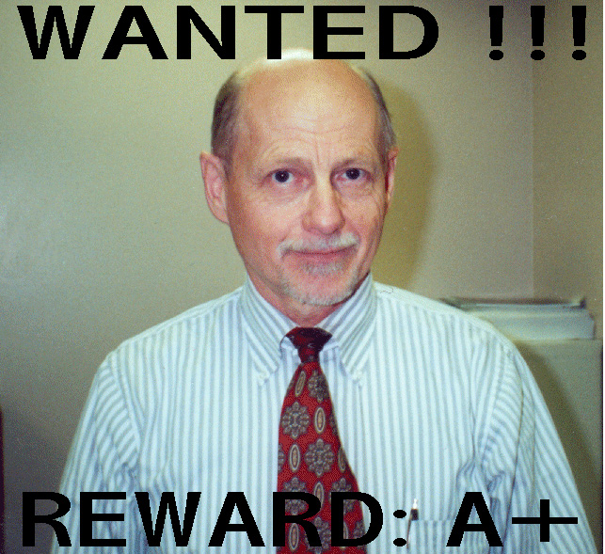

Slide 7
EIGENFACE TECHNOLOGY

Slide 8
EIGENFACE TECHNOLOGY
BIOMETRIC SYSYEMS IN DEVELOPMENT FOR OVER 20 YEARS
FACE IMAGE CAPTURED VIA CAMERA AND PROCESSED USING AN ALGORITHM BASED ON PRINCIPLE COMPONENT ANALYSIS (PCA) WHICH TRANSLATES CHARACTERISTICS OF A FACE INTO A UNIQUIE SET OF NUMBERS (TEMPLATE)
FACE PRESENTED IN A FRONTAL VIEW WITH WIDE EXPRESSION CHANGE

Slide 9
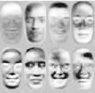
EIGENFACE TECHNOLOGY
A set of Eigenfaces - two-dimensional face-like arrangements of light and dark areas, as shown to the right, is made by combining all the pictures and looking at what is common to groups of individuals and where they differ most

Slide 10
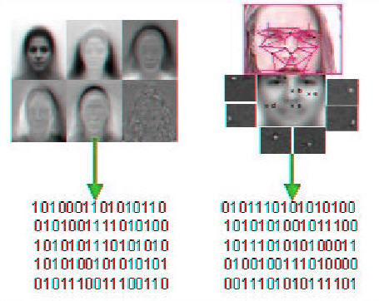
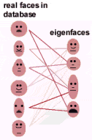
EIGENFACE TECHNOLOGY
To identify a face, the program compares its Eigenface characteristics, which are encoded into numbers called a template, with those in the database, selecting the faces whose templates match the target most closely, as shown to the right

Slide 11
LOCAL FEATURE ANALYSIS

Slide 12
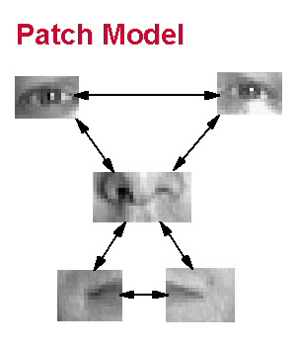
LOCAL FEATURE ANALYSIS
Local feature analysis considers individual features. These features are the building blocks from which all facial images can be constructed.

Slide 13
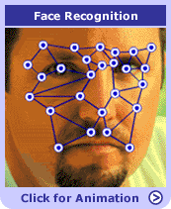
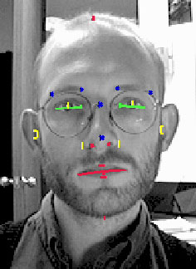
LOCAL FEATURE ANALYSIS
Local feature analysis selects features in each face that differ most from other faces such as, the nose, eyebrows, mouth and the areas where the curvature of the bones changes.
Features

Slide 14
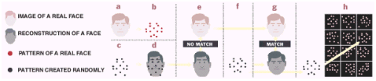
LOCAL FEATURE ANALYSIS
To determine someone's identity,
the computer takes an image of that person and
determines the pattern of points that make that individual differ most from other people. Then the system starts creating patterns,
either randomly or
based on the average Eigenface.

Slide 15
LOCAL FEATURE ANALYSIS
(e) For each selection, the computer constructs a face image and compares it with the target face to be identified.
(f) New patterns are created until
(g) A facial image that matches with the target can be constructed. When a match is found, the computer looks in its database for a matching pattern of a real person (h), as shown below.

Slide 16
PERFORMANCE ISSUES
From Eigenface Technology to Local Feature Analysis, the problems faced were same:
Images with complex backgrounds
Poor lighting conditions
Recognition accuracy.

Slide 17
NEURAL NETWORK TECHNOLOGY

Slide 18
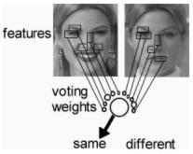
NEURAL NETWORK
TECHNOLOGY
Features from the entire face are extracted as visual contrast elements such as the eyes, side of the nose, mouth, eyebrows, cheek-line and others (Feature Extraction).
The features are quantified, normalized and compressed into a template code.

Slide 19








ARTIFICIAL NEURAL NETWORK
ANN technology gives computer systems an amazing capacity to actually learn from input data.
Feature
Extraction
Valid user/
Invalid
user?
Features provided
to ANN
Input Layer
Hidden Layer
Output Layer

Slide 20
  Since,the neural network learns from experience, it does a better job of accommodating varying lighting conditions and improves accuracy over any other method.

Slide 21
ADVANTAGES
DISADVANTAGES
Advantages
Less intrusive
Major security boost
Fast
Simple Recognition
Disadvantages
Breach of privacy
Comparatively less accurate
Expensive to implement

Slide 22
BIOMETRICS FUTURE
ADVANCES
BIOMETRIC SYSTEMS INTEGRATION SERVICES WHICH COMBINE FACE RECOGNITION SOFTWARE WITH OTHER BIOMETRICS, SUCH AS IRIS, VOICE, SIGNITURE, FINGERPRINT AS WELL AS EXISTING IDENTIFICATION CARD SYSTEMS
A PERSONS FACE WILL BE THE PRIVATE, SECURE AND CONVENIENT PASSWORD

